Slide 1
Coding Puzzles

Slide 2
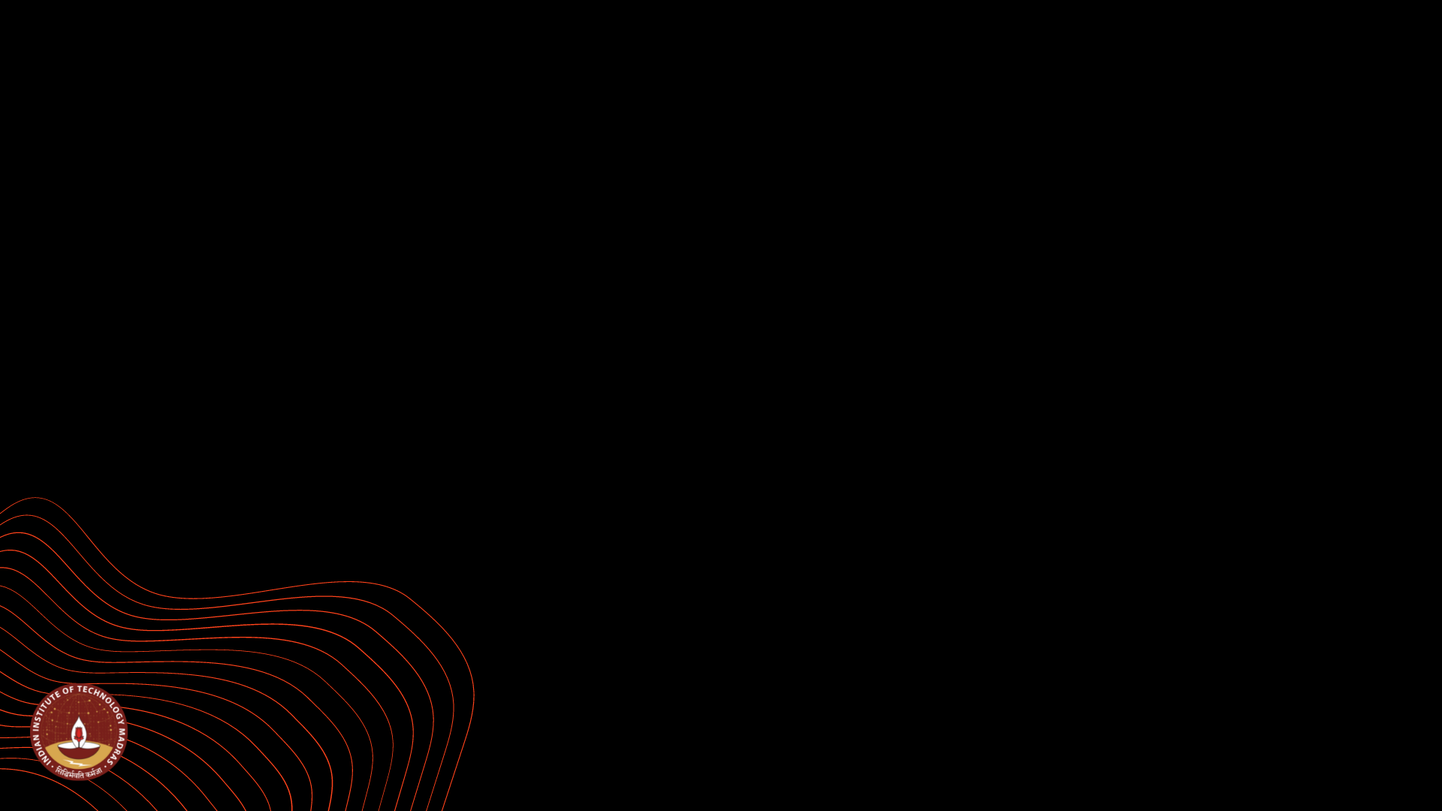
Coding_Puzzles : (Individual Project)
Tushar Shrikrishna Supe ( 21F1003637 )
I have completed BTech Mechanical engineering from VNIT Nagpur in 2019 and then worked in RIL for a year and then I joined this course in Nov 2020. Currently I have completed 12 courses in this program. My hobby includes web scrapping and python automation of common daily tasks. But learning python was little difficult for me because of non programming background. So I got this project idea from the way I learnt python programming.

Slide 3

The Problem
Many IITM BSC students are from non programming background. For them learning programming is difficult. Many students were looking for Python assignments answers even for basic questions because they were not able to understand why one piece of code passes all test cases and why their code doesn’t. And it actually required a little bit of practice and curiosity. So real problem is lack of practice and students can go for user friendly app which focuses on basic coding.

Slide 4

Solution
I learnt programming in a different way like not just looking at right piece of code but instead trying to run code by swapping lines or changing indents or functions and checking the output or errors thrown and learning why they were thrown and why correct code is actually ‘Correct’.
From this I got idea for ‘Coding Puzzles’. In this app a (beginner level) user will have to solve basic Python coding questions by re-arranging code lines / removing unwanted lines and adjusting indents on lines to get correct output. For every submission, user will output message stating that the code was correct or wrong along with proper error message and suggestions. So that, it will be easier for user to learn coding.
Right now this app is focusing on Python but in future other languages like HTML, Java, CSS, JS, SQL, C++, Linux commands will be added.
For this app, I have used Flutter and Firebase Cloud Database and Android Studio IDE.

Slide 5

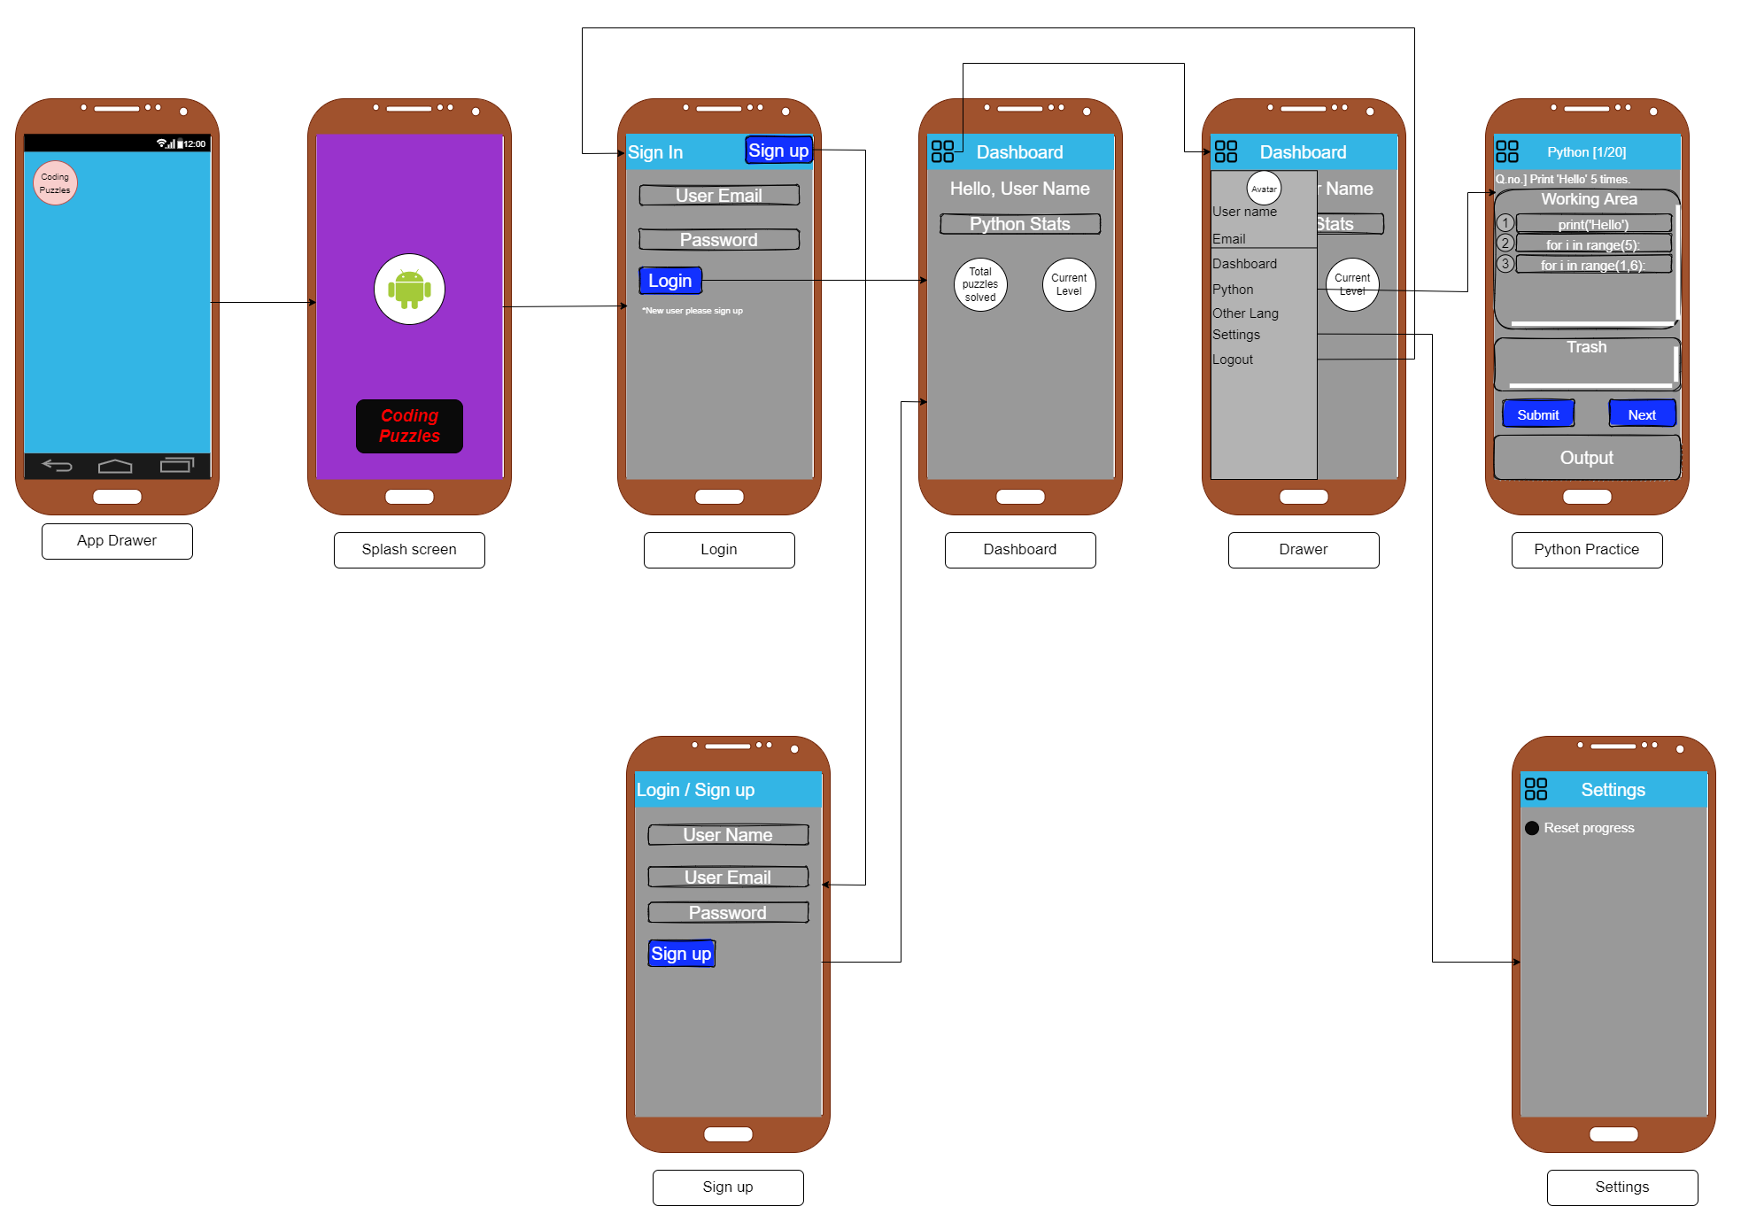
Wireframe/UI Design
Wireframe:
( Wireframe is made in
https://app.diagrams.net/ )
Links:
App layout (.drawio)
App layout (.pdf)
App laypot (.png)

Slide 6
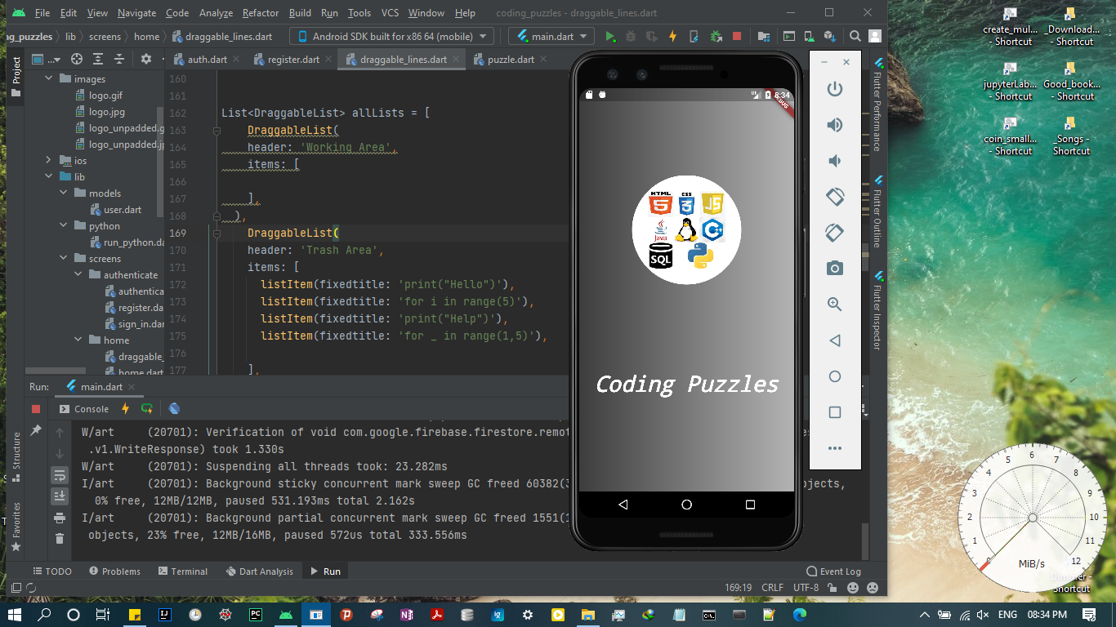
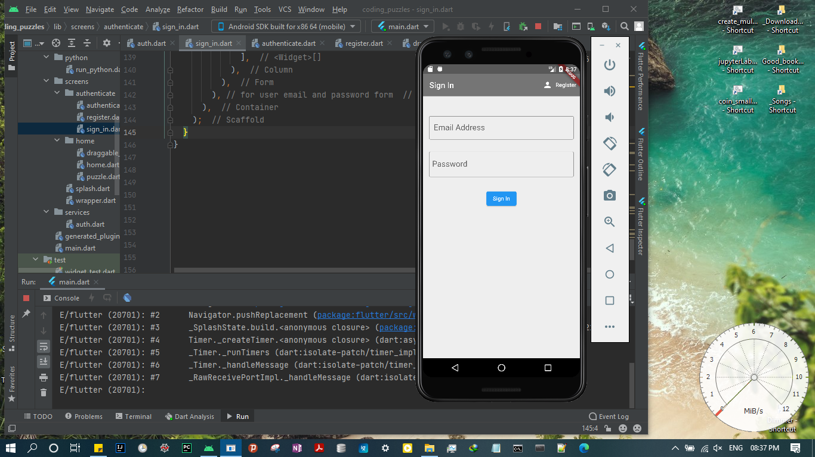
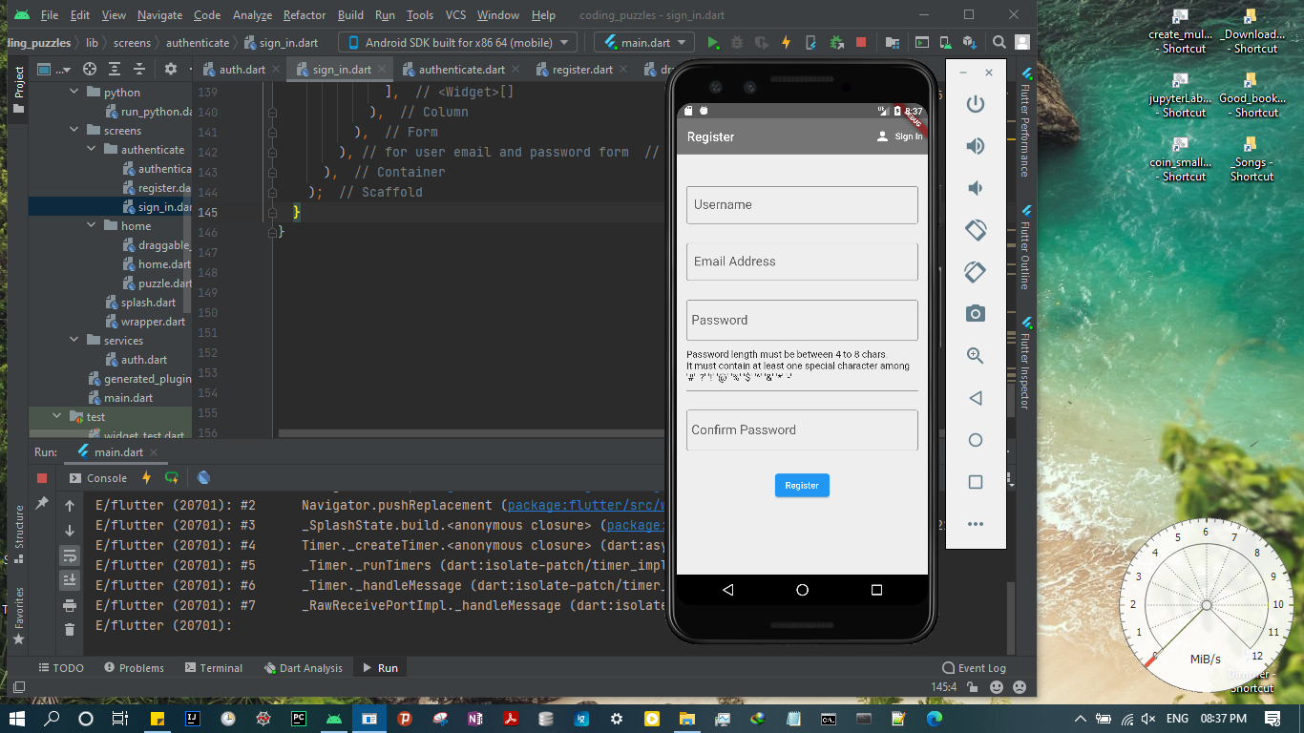
App Screens:
Splash Screen
Sign in Screen
Register Screen

Slide 7
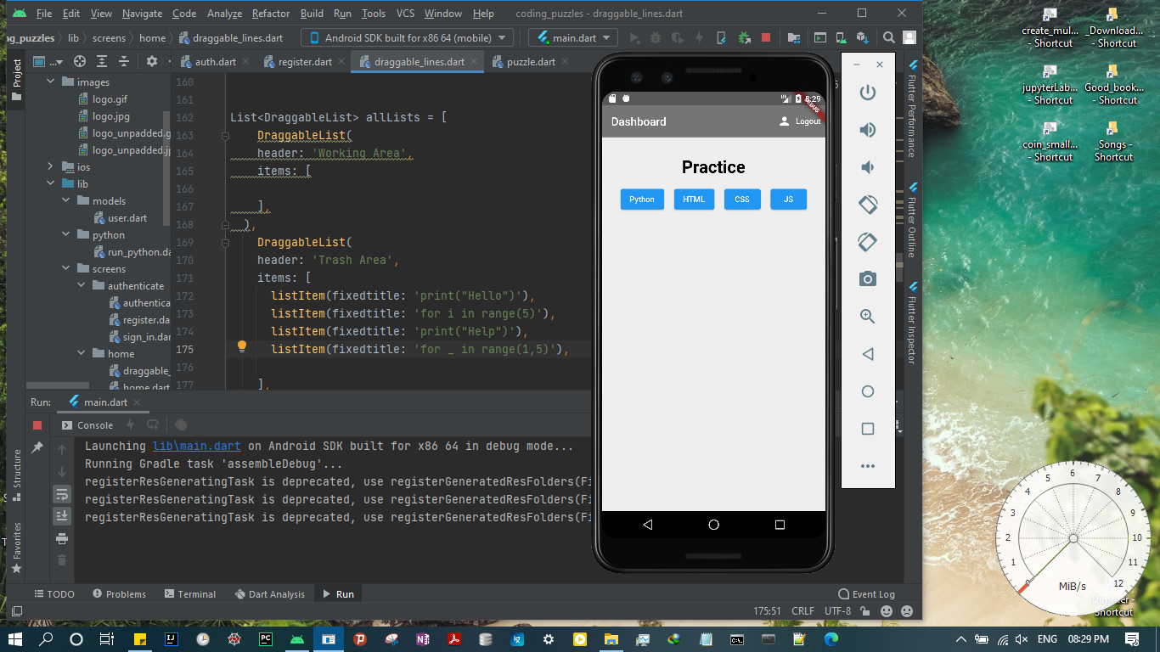
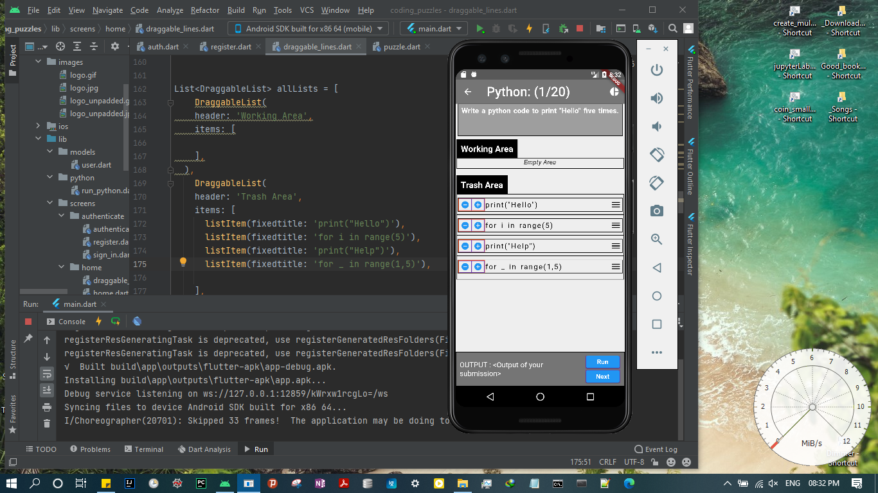
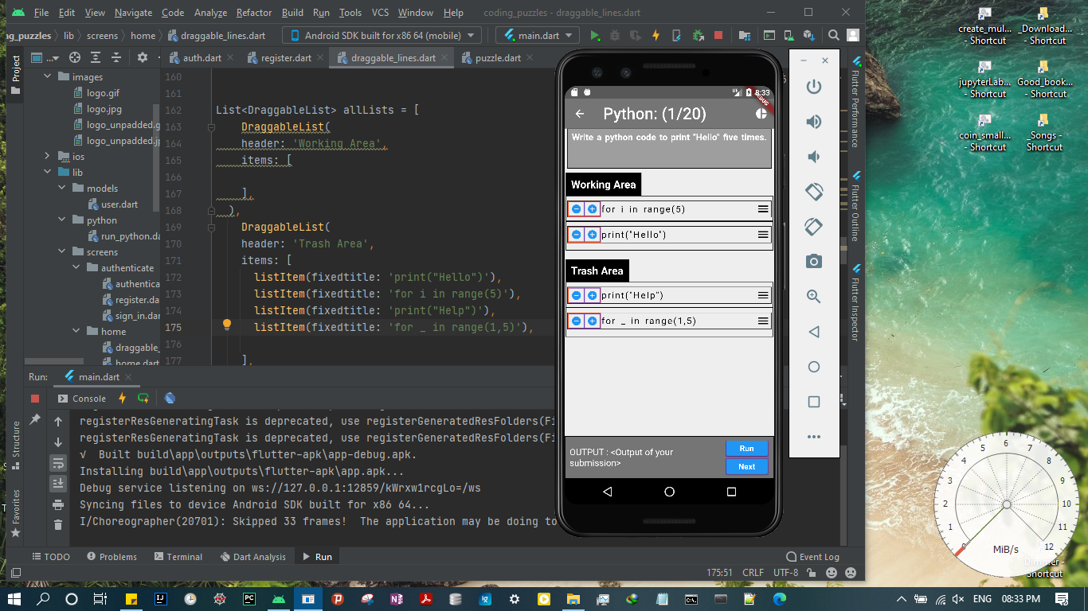
App Screens:
Dashboard Screen
Puzzle 1 Screen
Puzzle 2 Screen

Slide 8
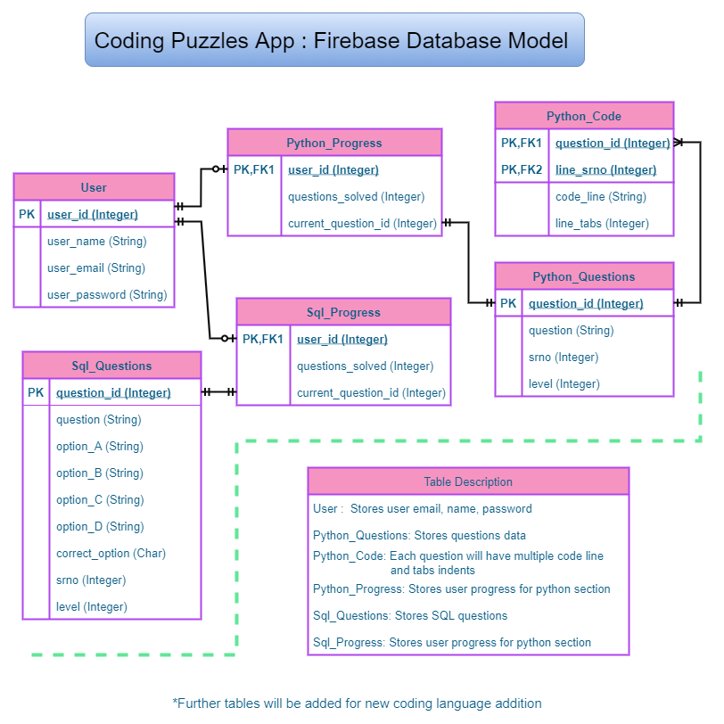
App Database Models:
App DB Model:
Links:
App DB (.drawio)
App DB (.pdf)
App DB (.png)

Slide 9
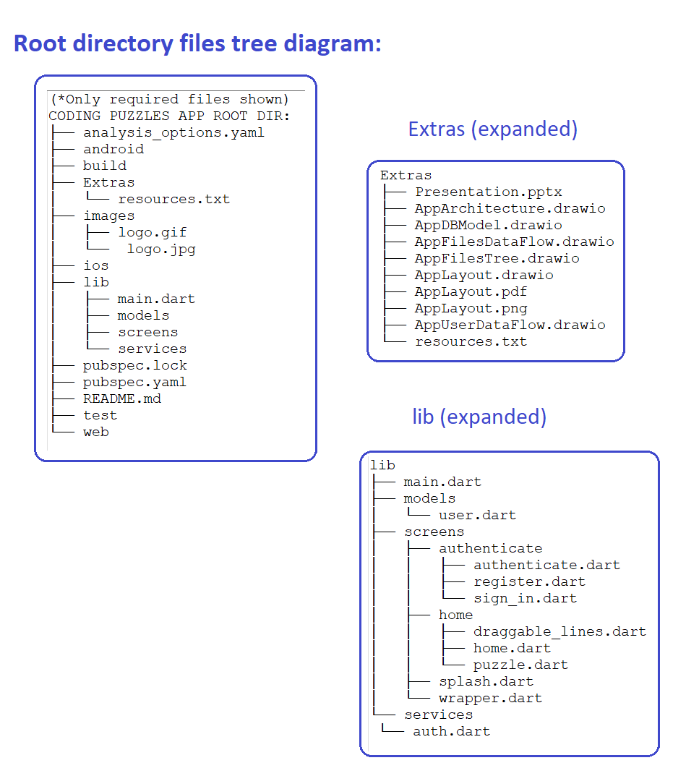
App Files Tree Diagram:
App Files Tree Diagram:
Links:
App Files Tree Diag (.png)

Slide 10
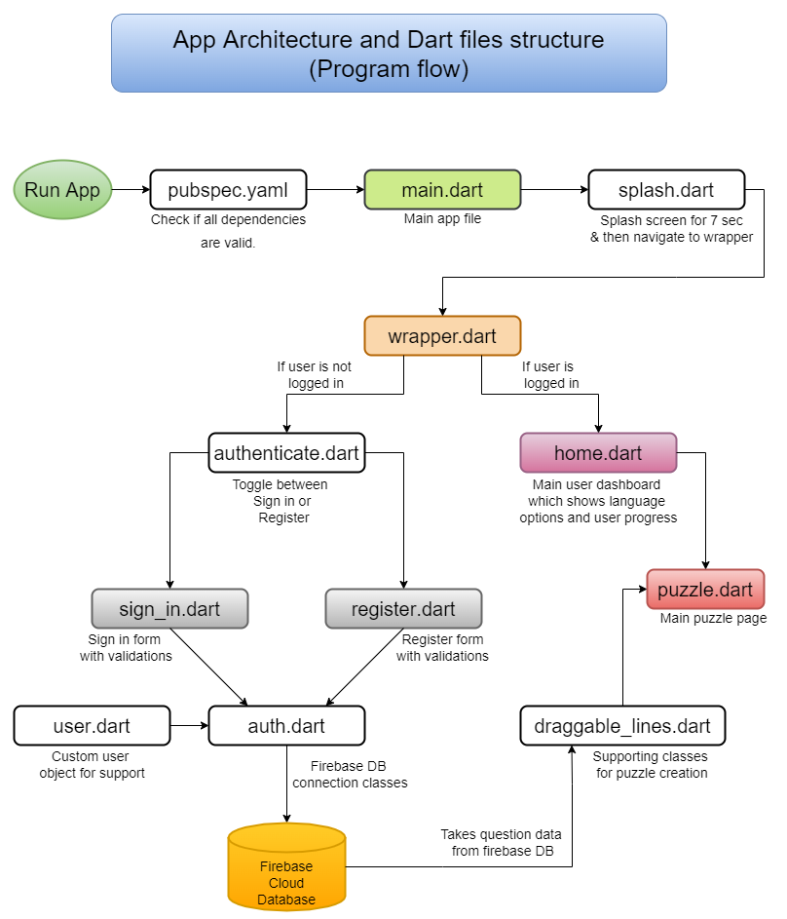
App Files Data Flow:
App DataFlow:
Links:
App DataFlow (.drawio)
App DataFlow (.pdf)
App DataFlow (.png)

Slide 11
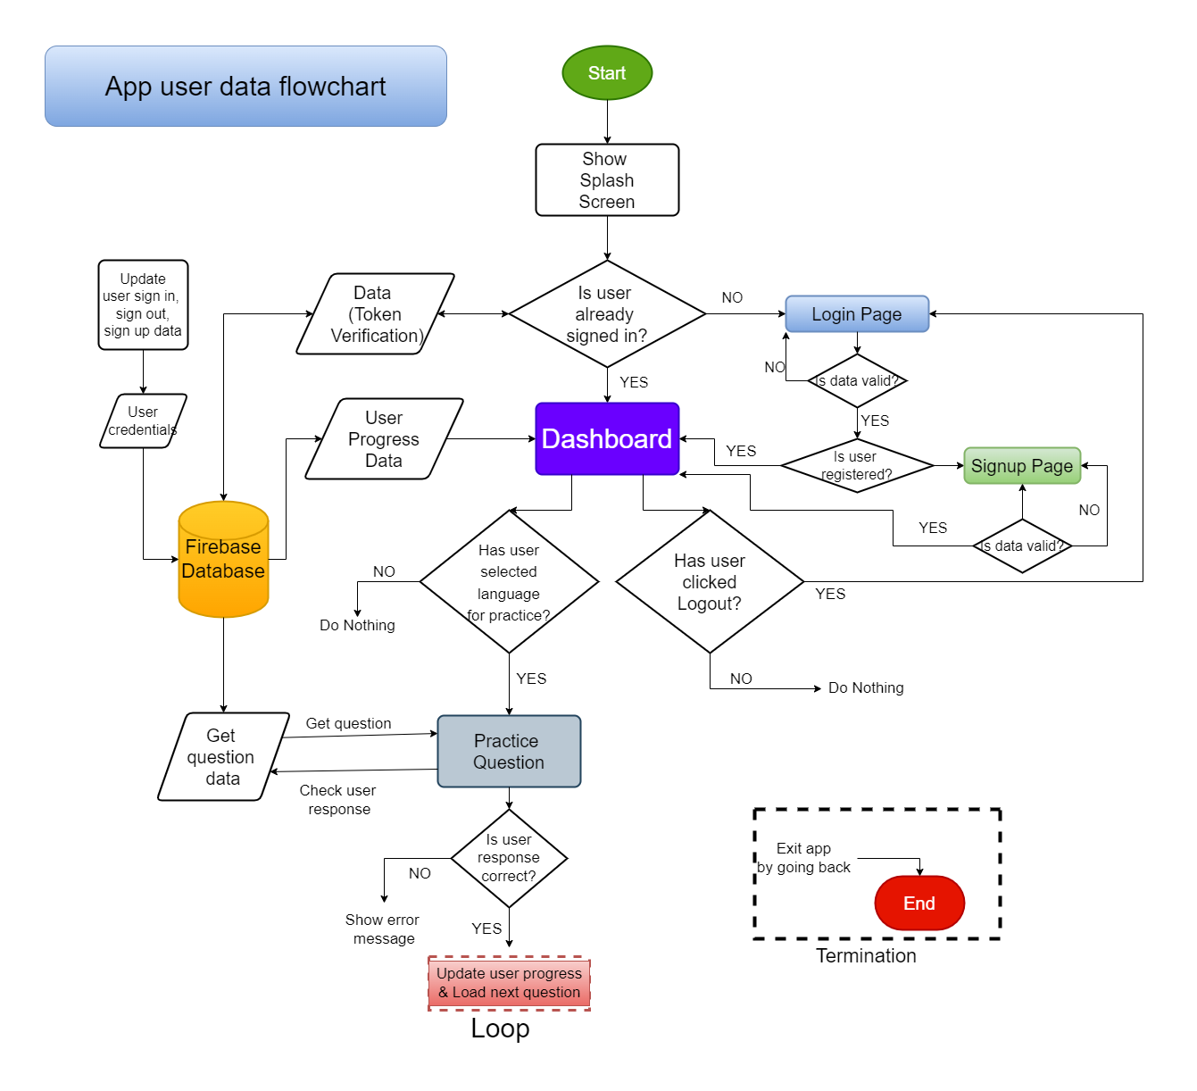
App User Data Flow:
App User DataFlow:
Links:
App User DataFlow (.drawio)
App User DataFlow (.pdf)
App User DataFlow (.png)

Slide 12
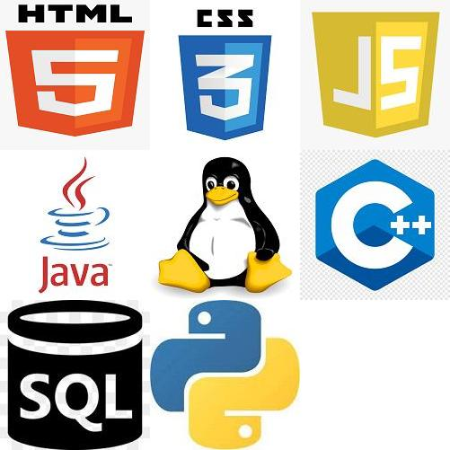
App Logo:
App Logo:
Links:
App Logo (.png)
App Logo (.gif)
This logo gif is made by me in Python using numpy, pillow,
opencv without using any readymade software.

Slide 13

Scope for Improvement
Including sliding drawer in app.
Adding integrated python interpreter.

Slide 14

THE END

